Slide 1

DHE Learning Outcomes Assessment Update
Dr. Robert Awkward, Director of Learning Outcomes Assessment
November 30, 2018

Slide 2

Going Forward
Amcoa Team Meetings (all at QCC):
  Fri., Sept. 28: “Institutional Assessment Program Panel: Learning from Our Peers”
  Fri., Nov. 30: Dr. Patricia O’Brien, SND, Sr. Vice President, and Dr. Laura Gambino, Vice President at the New England Commission for Higher Education
  Fri., Feb. 1: TBD
  Fri., March 29: TBD
Task Force on Statewide Assessment (all at QCC):
  Oct. 16: Dr. James Dottin, Chair, Business Administration Department, Middlesex Community College
  Jan. 17: TBD
  March 8: TBD
Eighth Annual Assessment Conference: Place and date TBD

Slide 3
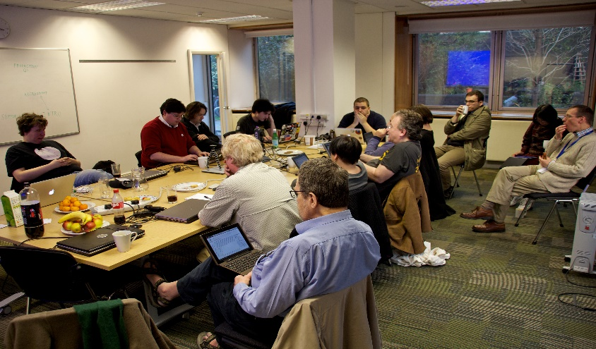
Going Forward
Regional Professional Development
Assignment Design & Rubric Alignment Charrettes
  Objectives: Improve student learning, links learning & teaching with assessment, better data, and equity
  Expected Outcomes: Increase participation in VALUE Institute, create more effective assignments, and employ the use of TILT design
  Targeted to faculty
  Incentives for attendance: Hands-on session using their own assignment, held on Friday, and food/refreshments
  Regionally located:
    North Region at North Shore Community College on November 2 (9am – 1pm)
    Boston Metro Region at UMass Boston on Friday, December 7 (9am – 1pm)
    Central Region at Worcester State University, January 2019
    Western Region at Westfield State University, February 8, 2019
  Use local assessment leaders as faculty (Dr. Bonnie Orcutt and Dr. Sarah Strout, Worcester State University)

Slide 4

Going Forward
Regional Professional Development
Quantitative Literacy Workshops
  Objectives: Addresses area of focus from Refinement Year MSC, improve student learning, expands the use of quantitative literacy across the curriculum, links learning & teaching with assessment, better data, and equity
  Expected Outcomes: Create more effective assignments, employ the use of TILT design, and illustrate student utilization of quantitative literacy
  Targeted to cross-discipline faculty
  Incentives for attendance: Hands-on session using their own assignment, held on Friday, and food/refreshments
  Regionally located, i.e., West, Central, North, Boston Metro, and Southeast (Bridgewater State)
  Support the SEQuel Conference at Bridgewater State
  Spring 2019
  Host guest speakers and showcase local faculty

Slide 5


MassTransfer Pathways Student Learning Outcomes
Carryover from AY 2018
Business Administration
Criminal Justice
Early Childhood Education
New for AY 2019
Elementary Education
Engineering
Fine Arts & Graphics
General Education:
  Behavioral & Social Sciences
  Humanities & Fine Arts
  Natural & Physical Sciences
  English Composition/Writing
  Math
Math

Slide 6
Open Educational Resources (OER) Working Group
Kickoff meeting held on Monday, November 26 at Quinsigamond Community College
Presenters included:
  DHE (Pat Marshall, PIF, and Government Relations)
  Student Advisory Council
  Institutions (#GoOpen, Northern Essex, Salem State and UMass Amherst)
  Nicole Allen, Director of Open Education, SPARC (Scholarly Publishing and Academic Resources Coalition)
Established sub-committees:
Conducting an OER Prevalence Survey
Timetable – Complete its work by early April 2019
Stakeholders | Legislation/Policy Development
Marketing & Communications | Faculty Education
OER Infrastructure

Slide 7
OER Working Group Members
Matt Bejune, Executive Director, Libraries, Worcester State University
Marilyn Billings, Head, Office of Scholarly Communications Library, University of Massachusetts Amherst, Co-Chair
LaDonna Bridges, Associate Dean of Academic Success, Framingham State University
Barry Brown, Follett Bookstore Manager and Adjunct English Faculty, Middlesex Community College
Jody Carson, Associate Professor of Early Childhood Education, Northern Essex Community College
Cherie Comeau, Sr. Manager, Leadership & Organizational Development, Consigli Construction Co., Inc.
Eileen Cusick, Associate Professor of Information Technology, Springfield Technical Community College
Catherine Sughrue Etter, Professor of Science, Cape Cod Community College
Millie Gonzalez, Interim Chief Diversity & Inclusion Officer, Framingham State University
George Hart, Director of Libraries, University of Massachusetts Lowell
Karen Hines, Associate Professor of Business & Technology, Holyoke Community College

Slide 8
OER Working Group Members
Elizabeth McKeigue, Executive Director, Libraries, Salem State University
Apurva Mehta, Associate Chief Information Officer, University of Massachusetts Boston
Christopher J. O’Donnell, President, Massachusetts State College Association; and Professor of Science & Math, Massachusetts Maritime Academy
Arlene Rodriquez, Vice President of Academic Affairs, Cape Cod Community College
Donna Maturi, Coordinator of Library Services, Professional Development, Middlesex Community College
Jeremy Smith, Digital Project Manager, University of Massachusetts Amherst
Susan Tashjian, Coordinator of Instructional Technology, Northern Essex Community College, Co-Chair
Margaret Wong, President, Massachusetts Community College Council
Adrienne Wooters, Associate Dean, Academic Affairs, Massachusetts College of Liberal Arts
Two student representatives from the Student Advisory Council: Morgan Mayo (Middlesex Community College) and Nick Papa (Salem State)

Slide 9

AAC&U VALUE Institute Webinar
Webinar - The Landscape of Learning: What We Know from the Inaugural Year of the VALUE Institute
December 4, 2018
Online, 2:00-3:00 p.m., ET
Webinar Cost: Free for AAC&U Members, $200 for nonmembers
Register today!

Slide 10
Questions…Comments?
Thank You!!

